Slide 1
DATA TRANSFER via UART
Team 8: Project Overview and Implementation Presented by: Ashritha and Sujitha

Slide 2
AIM AND OBJECTIVE
Send data via uart using device drivers(module programming).
The objective of this project is to implement a UART (Universal Asynchronous Receiver-Transmitter) driver on a Raspberry Pi using a Linux kernel module. This module will enable the transfer of data between devices over UART, allowing serial communication.

Slide 3
OVERVIEW
The UART communication protocol is widely used in embedded systems for transferring data between devices. It allows for data transmission one bit at a time over a single data line. This describes the steps involved in implementing a simple UART driver using the Linux kernel module on the Raspberry Pi.
This module opens a UART port (/dev/<dev_name>), supports reading and writing to it, and provides basic error handling for common communication issues. The goal of this implementation is to demonstrate how to use Linux kernel facilities to communicate via UART.

Slide 4
METHODOLOGY INVOLVED
1. Initialize UART Communication
2. Device Registration
3. Opening and Closing UART Device
4. Reading and Writing Data
5. Error Handling

Slide 5
FLOW DIAGRAM
Start (Load Kernel Module)
Trigger: insmod loads the kernel module.
Initialize UART Communication
Action: Call uart_init() to register the character device.
Open UART Device (Call uart_open())
Action: User space app opens the device (e.g., /dev/ttyS0).
UART Device Open Check
Success: Proceed to the next step. Failure: Log error, exit process.
Send Data (Call uart_write())
Action: Write data to UART device (via echo or other program).
Check for Data Availability (Call uart_read())
Action: Kernel checks if data is available for reading.
Data Available / No Data
Data Available: Read and process data using uart_read(). No Data: Return without action.
Exit (Unload Kernel Module)
Trigger: rmmod unloads module. Action: Call uart_exit() to unregister the device.
https://github.com/shweatank/Mirafra_LDD_BATCH/tree/ashrithareddy/PROJECT

Slide 6
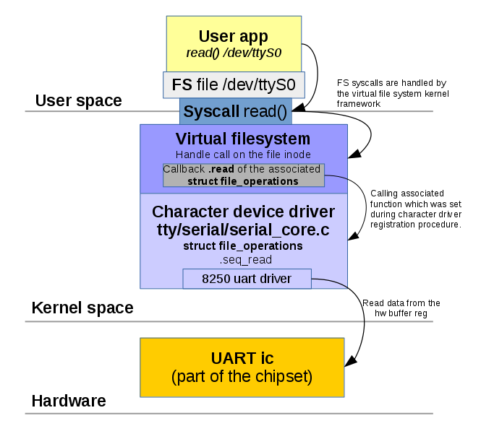
BLOCK DIAGRAM

Slide 7
BAREMETAL UART
Start (Load Kernel Module)Trigger: insmod loads the kernel module.
Initialize UART Communication:(MMIO) region is mapped using ioremap() function and character device is registered.
Open UART Device: The dev_open() function is called here.
Send Data: dev_Write() is called and check checks if the UART transmitter is ready by reading the UART_STATUS register. Writes data to UART_DATA register.
Check for Data Availability: dev_read() is called and driver checks if data is available by reading the UART_STATUS register. Reads data from UART_DATA register.
Close UART Device: dev_release() is called here.
Exit (Unload Kernel Module): kernel module is unloaded using rmmod and Unmaps the UART MMIO region using iounmap(). Destroys device node and class and unregisters character device.

Slide 8
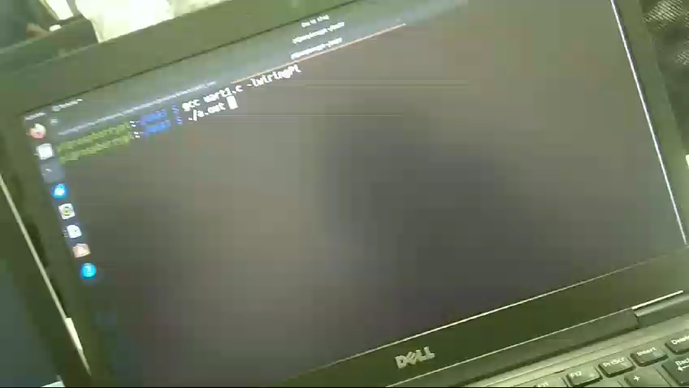
RESULT

Slide 9
CONCLUSION
This UART driver module successfully implements serial communication on the Raspberry Pi using the Linux kernel. The system facilitates basic data transfer between devices over UART, including sending and receiving data. The module also handles opening and closing the device, reading and writing data, and error handling, providing a simple yet robust method for serial communication. This implementation can be further extended for more complex use cases, such as interfacing with microcontrollers or sensors.

Slide 10


Slide 11


